Slide 1

Creativity in Design and Innovation
Members:
Ayda
Corrado
Elham
Pratik
Shreyas

Slide 2
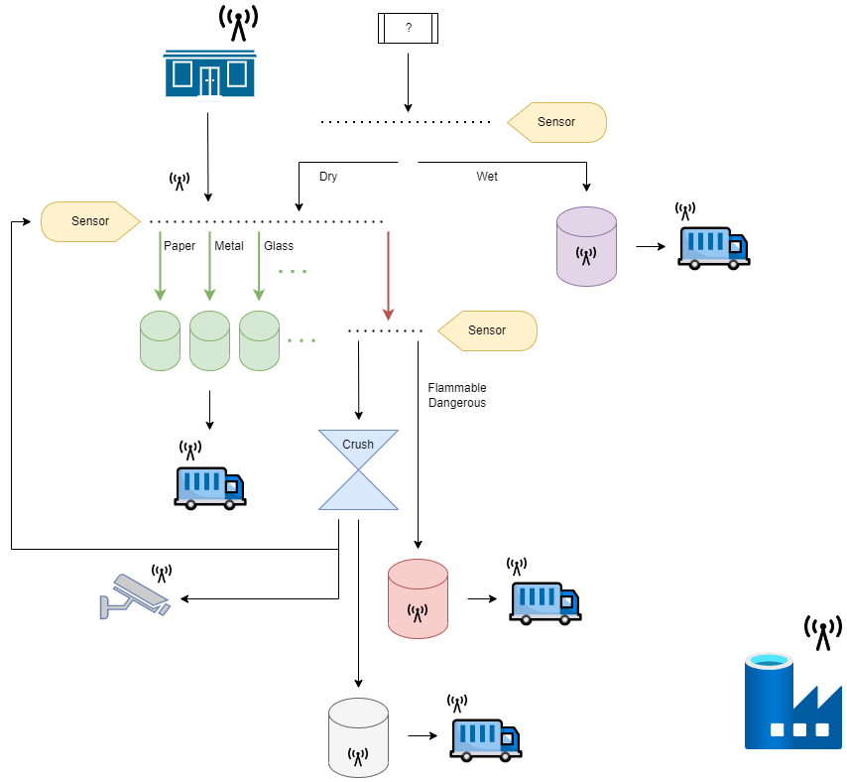
System Architecture

Slide 3
TRIZ Matrix
 | Volume of waste container | Measurement accuracy in segregation | Sorting Reliability | Ease of repair | System ad sub-system complexity | Manufacturing the system
Volume of waste container |  | 9, 3 | 15, 1, 19 | 15, 23 |  | 1, 6
Volume of waste |  | 1, 15 | 1, 5 |  | 2, 5, 7
Ease of operation of the system | 2, 1, 10, 16
Worsening Feature
Improving Feature

Slide 4
9 Boxes
​ | Past​ | Present​ | Future​
Super-System​ | Bin​ Bin Bags​ Local Dust Bins​ | Locality​ Municipality​ People, Animals, Birds etc.​ | Clean Environment​ Eco-Friendly​
System​ | Mixed Garbage​ | Collect​ Sort​ | Disposal​ Recycle​
Sub-System​ | Develop smart algorithm​ Smart Interface​ | Collecting System​ Collection of Data​ | Optimize​ Improve​

Slide 5
Value Map
Performance
Fast Sorting
Silent
Harm
Eco-friendly
Recyclable system
Interface
Easy to use
Connectivity
Cost
Reliable
Auto compact
Enough capacity
Smell observation
Easy maintenance
Modular design
Data monitoring
inexpensive
Energy efficient
Integration with smart home systems or voice assistants
Real time monitoring
Lower production costs
Value = Function(Performance, Harm, Interface, Cost)

Slide 6
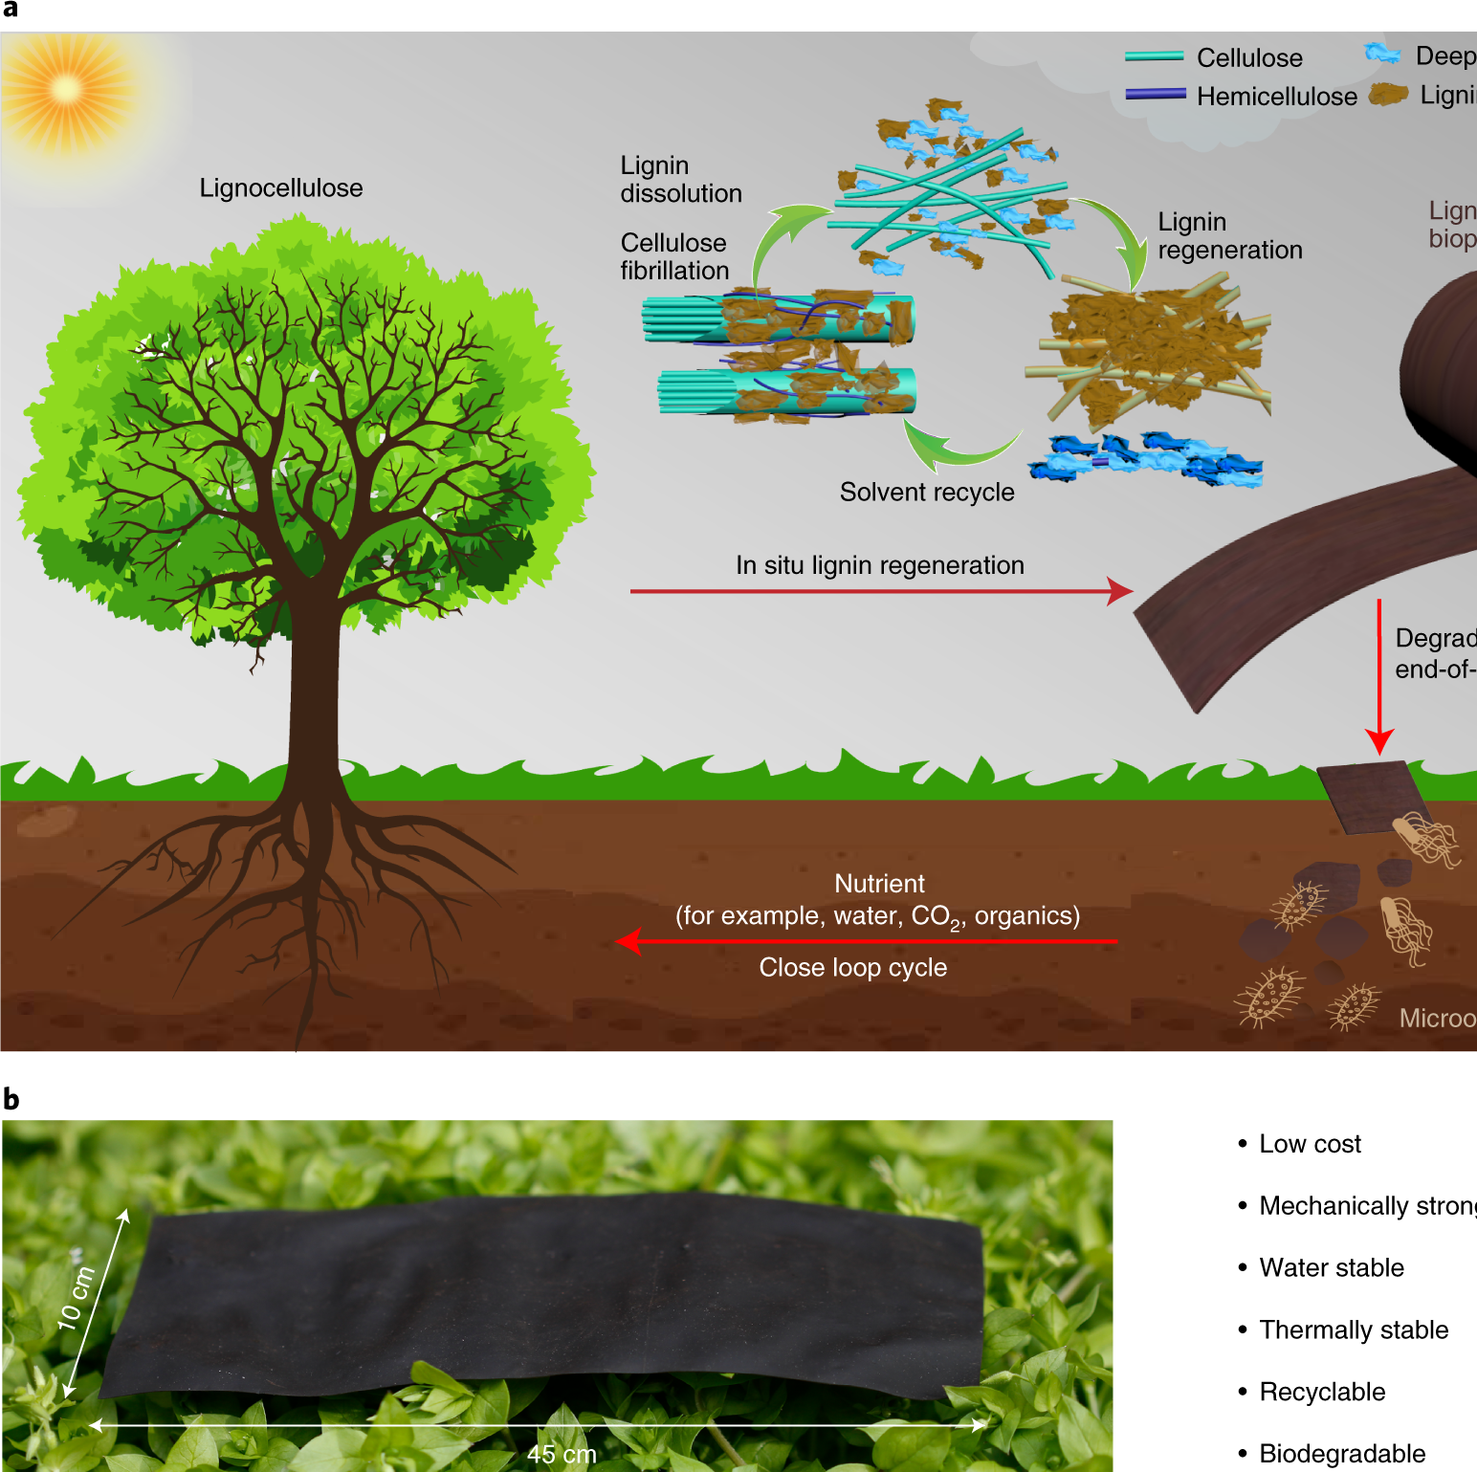
Similar DNA
Smart sorting technologies in industry:
Hyperspectral Imaging: sorting based on material properties like color, shape, and texture.
Robotics: Make sorting decisions based on visual cues.
Near-Infrared (NIR) Spectroscopy: Identify different types of materials based on their chemical composition.
Radio-Frequency Identification (RFID): RFID tags can be attached to materials and used to track them
Barcode Scanning: To identify and sort items
Recycling technologies inspired from Nature:
Biodegradation: Use bacteria and fungi to break down organic matter into simple compounds

Slide 7

Quick Estimation
An engineer should be able to make quick estimates:
By having rough idea
Common Sense
By doing math (with physics)
Buckingham Pi Theorem

Slide 8

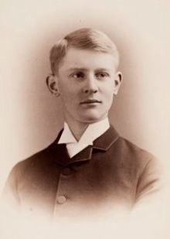
Buckingham Pi Theorem
Solve by Physics and Math or use Buckingham Pi Theorem
Buckingham Pi can reduce the computation time
Used to make a scaled down version of actual system:
Scaled down model reduces the cost
Mimics the actual model
Relation between parameters

Slide 9
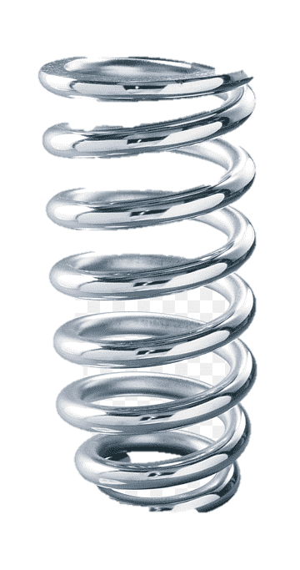
Metal Separation System
Insulation
Boiling Beaker
Heating Coil
Mounting with Stiff spring for shaking

Slide 10

Thank You!!!

